Slide 1

FAST FACTS ABOUT…
RUBBER MODIFIED ASPHALT (RMA)

Slide 2
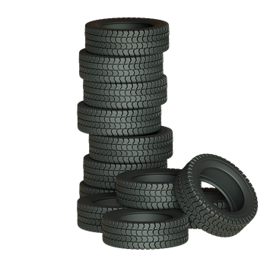

Rubber modified asphalt (RMA) is a mixture of recycled ground tire rubber and asphalt.
RMA is a promising end-of-life market for the 270 million recycled tires generated annually in the U.S., as each lane mile paved with RMA uses up to 2,000 recycled tires.
WHAT IS RMA?
Source: Summary of State Specifications for Rubber Modified Asphalt

Slide 3
RMA provides proven economic, performance and environmental benefits, compared to traditional asphalt, in building better, longer lasting roads and highways.
WHAT ARE THE BENEFITS OF RMA?
Longer Service Life
Better Ride Quality
Reduced Tire Wear
Increased Safety
Reduced Emissions
Source: Summary of State Specifications for Rubber Modified Asphalt

Slide 4
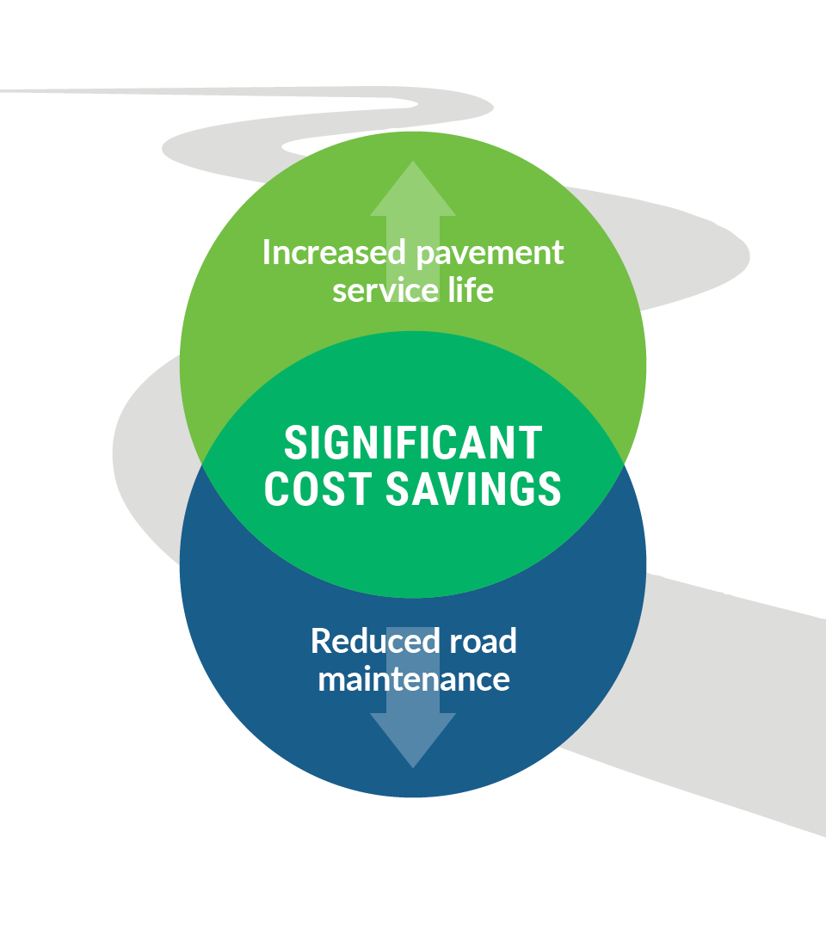
RMA is very resistant to cracking in both high-traffic and low-temperature situations.
Fewer roadway cracks reduce the need for maintenance, providing localities with a significant cost savings.
PERFORMANCE & SAVINGS
Source: Summary of State Specifications for Rubber Modified Asphalt

Slide 5

RMA has been shown to create smoother pavements and thus better ride quality for motorists.
In wet conditions, using RMA provides better pavement skid-resistance and reduces road spray, which increases road safety.
RIDE QUALITY & SAFETY
Source: Summary of State Specifications for Rubber Modified Asphalt

Slide 6
💰Cost Savings: Fewer cracks and repairs mean lower maintenance costs for cities and taxpayers.
🛣 Longer-Lasting Roads: RMA is more resistant to wear and tear, making roads more durable.
🚙 Reduced Vehicle Wear: Smoother pavement improves ride quality and reduces vehicle wear.
⚠️ Increased Safety: RMA provides better skid resistance and reduced road spray in wet conditions.
♻️ Supports Circular Economy: RMA utilizes recycled tires, contributing to the circular economy.
RMA: A SMART CHOICE FOR ROADS
Source: Summary of State Specifications for Rubber Modified Asphalt

Slide 7
By using RMA, communities can invest in roads that last longer, save money and create a safe and more sustainable future.

Slide 8
LEARN MORE ABOUT
RMA ON USTIRES.ORG.

