Slide 1
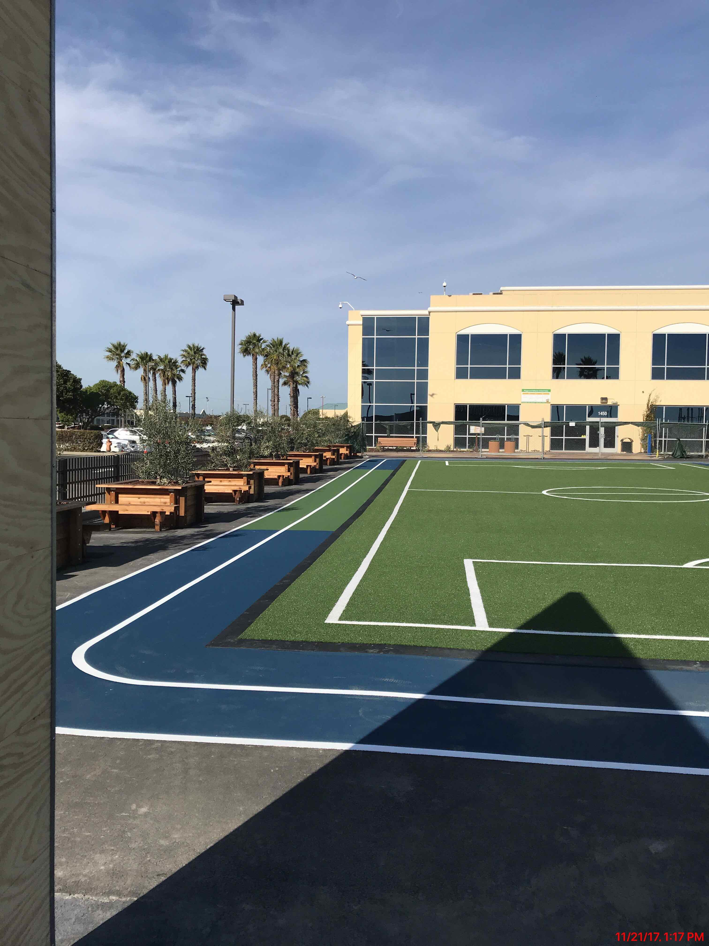
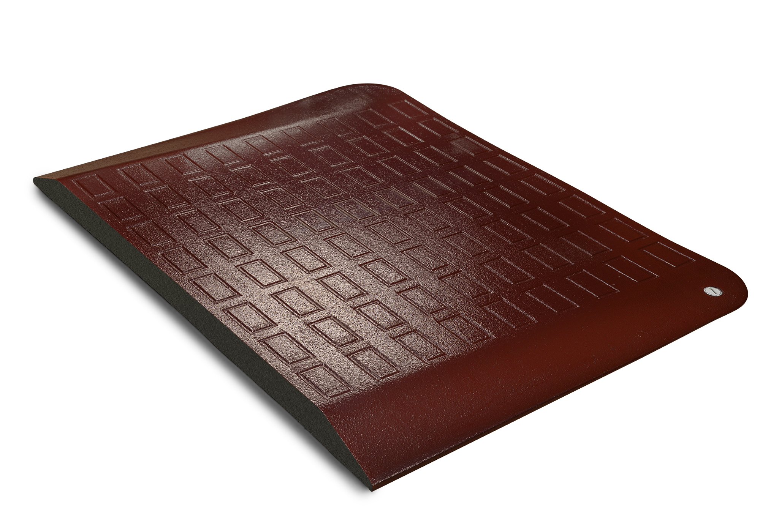
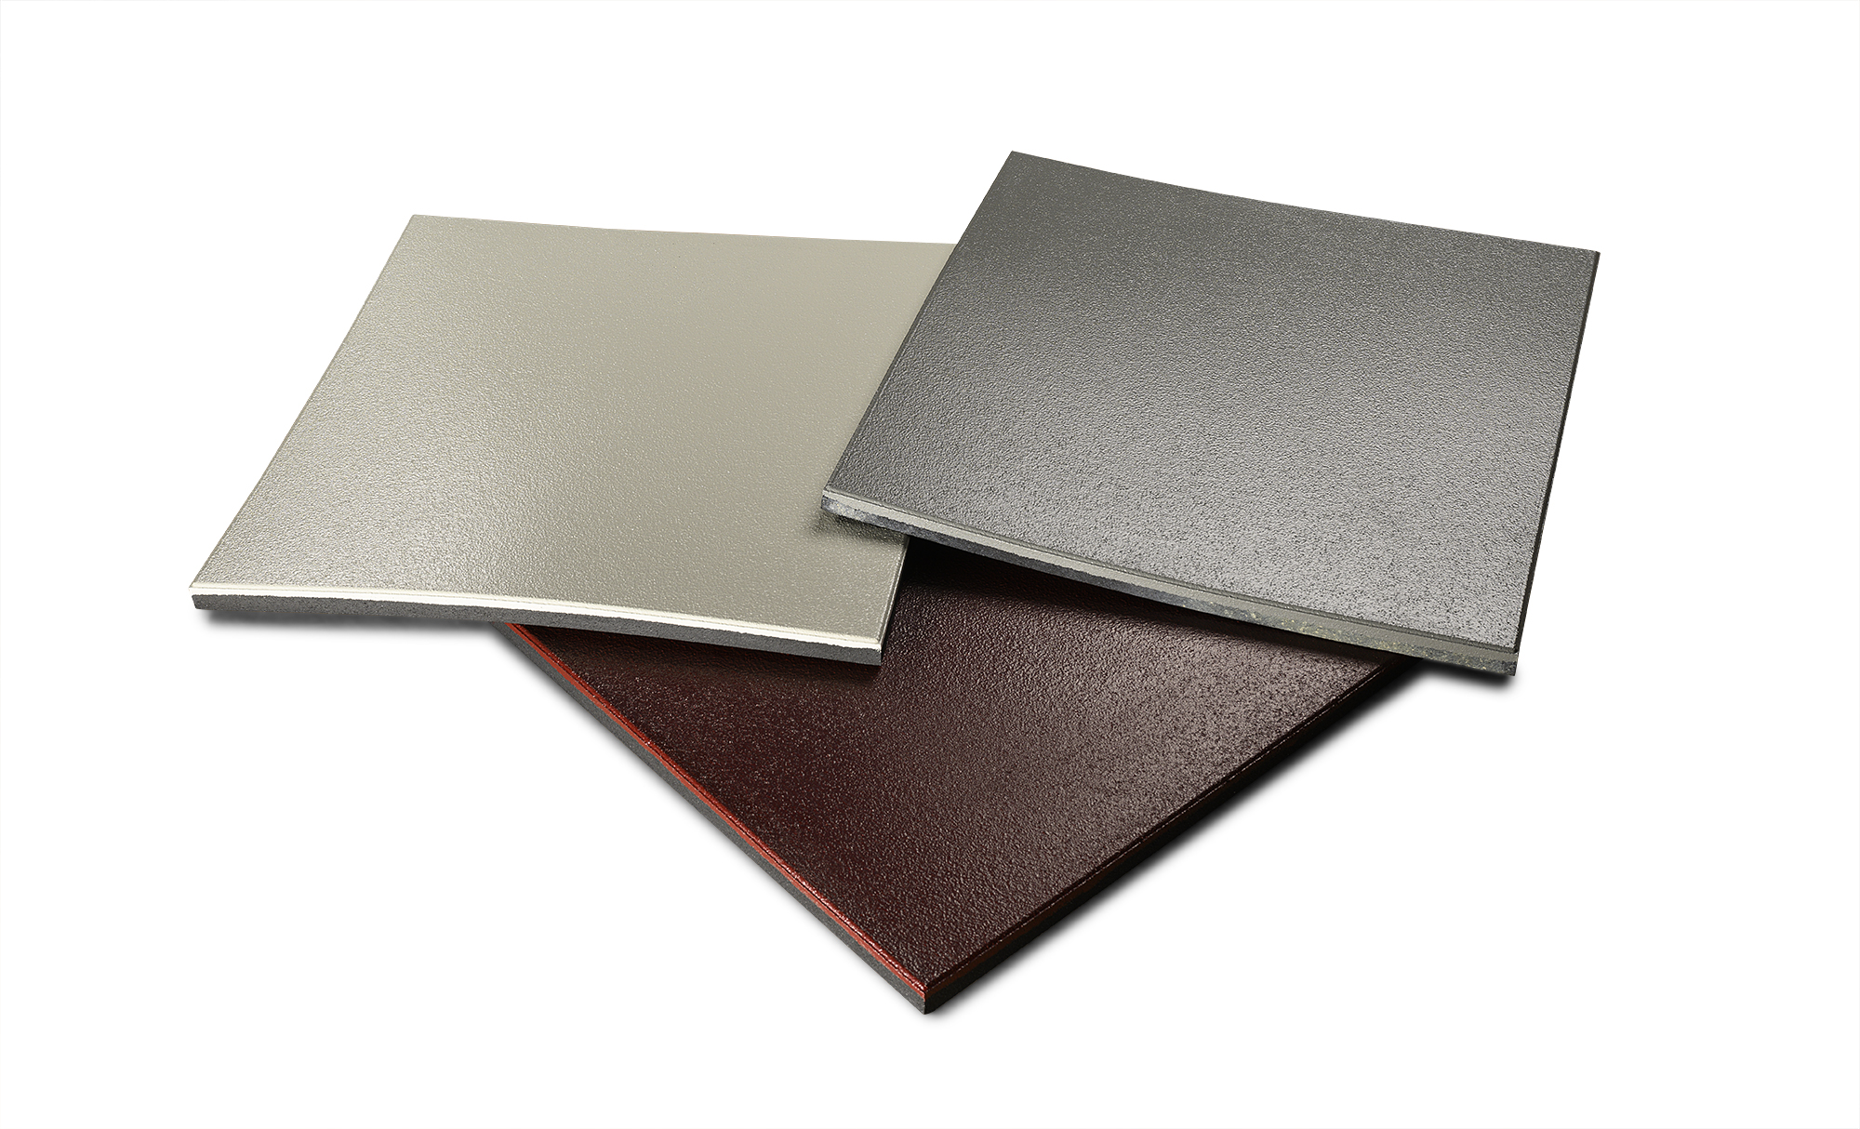
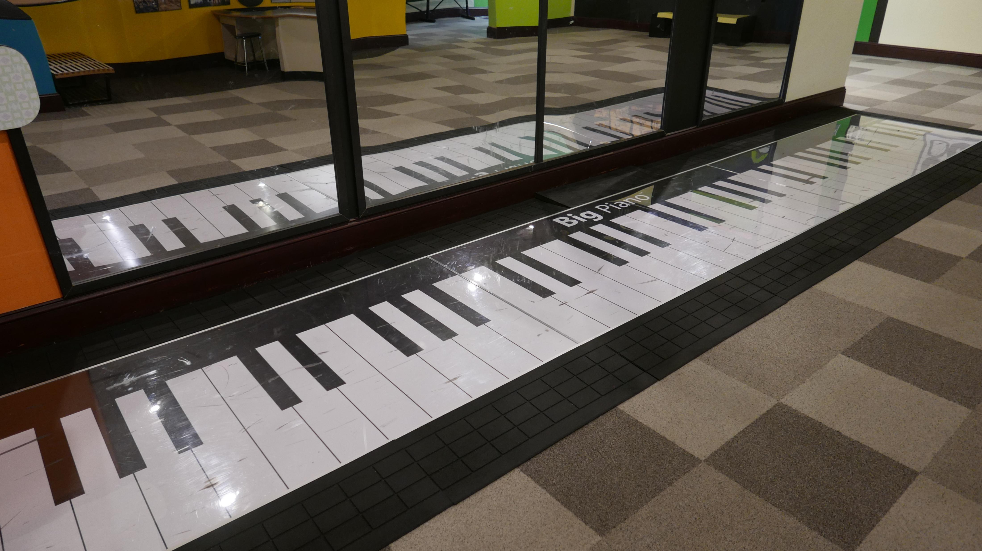
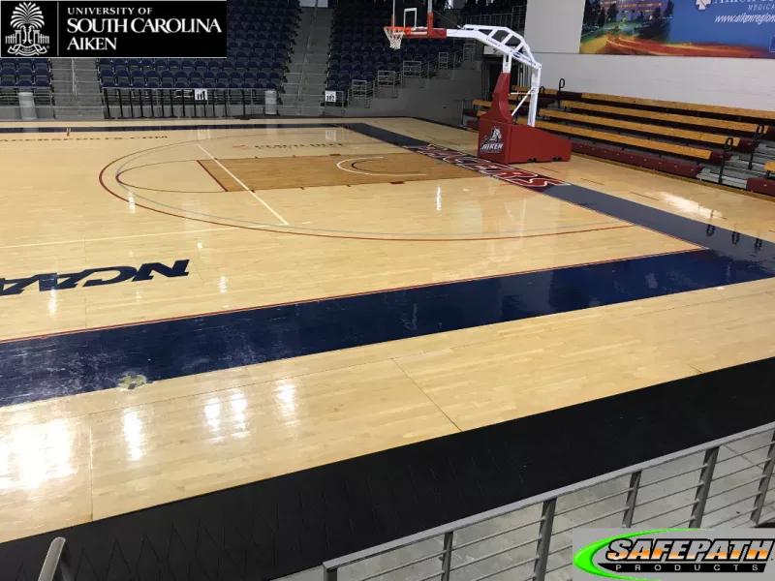
Examples of Commercial Products Made from Recycled Tires
Molded & Extruded Products
Photos Courtesy of Tim VanderHeiden, SafePath Products

Slide 2


Slide 3
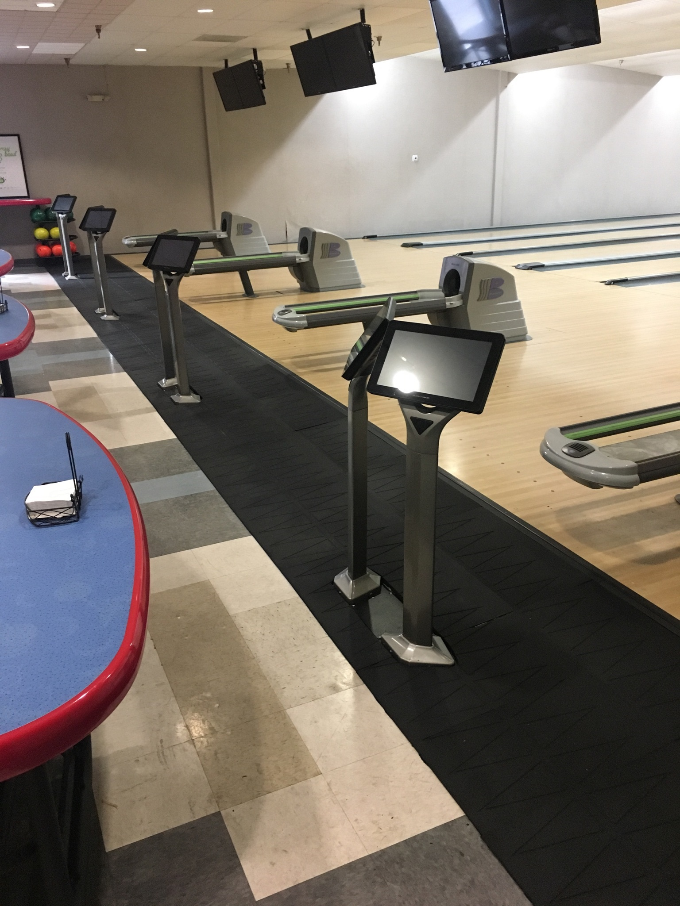
Bowling alley floors made from recycled tires
Athletic track made from recycled tires

Slide 4
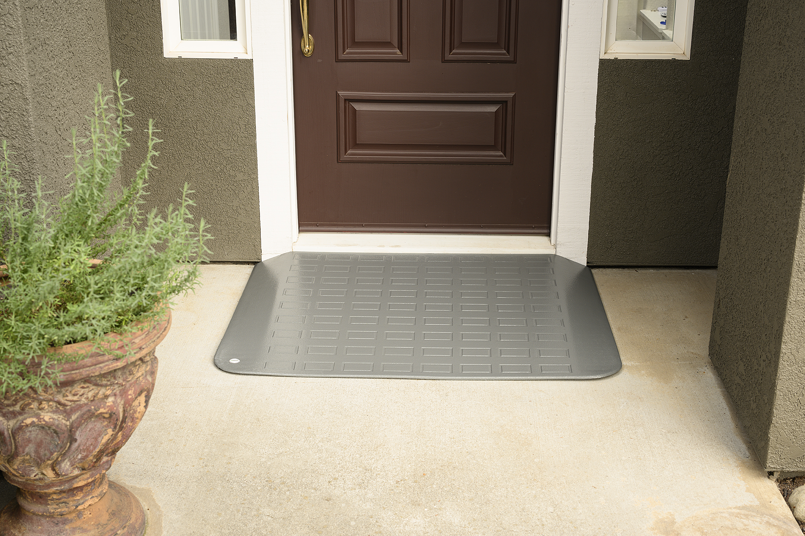
Doormat made from recycled tires

Slide 5
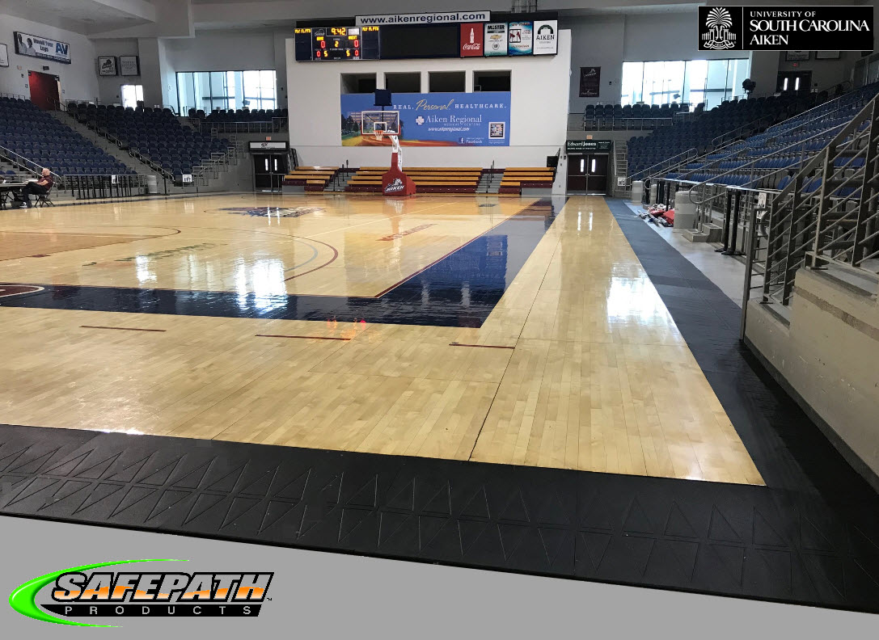

Slide 7
Floor tiles made from recycled tires

Slide 8
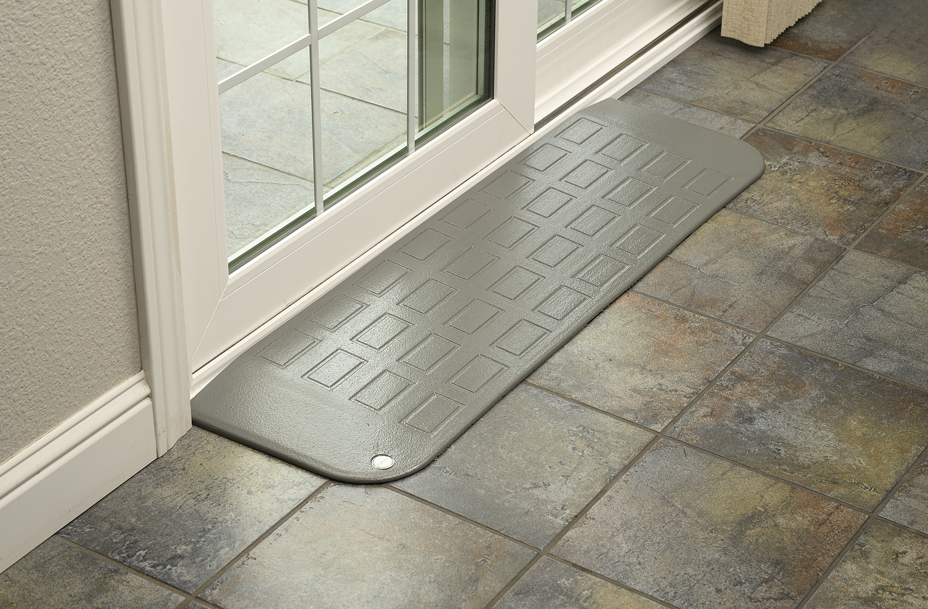
Doormat made from recycled tires

Slide 10
Doormat made from recycled tires

